Slide 1


DevFuse: Empowering Collaboration and Learning in Tech
Presented By: Sathyashree P
Email: 25dp1000009@ds.study.iitm.ac.in
Mobile: 9786984094
Where Ideas Spark, Skills Fuse, and Innovation Flows

Slide 2
What is DevFuse?
DevFuse is a platform designed to connect creators, learners, and innovators to collaborate on projects, learn new skills, and implement ideas.
Key Features:
Collaborative project matching
Skill-based search for team members
Interactive learning environment

Slide 3
The Need for DevFuse
Many people struggle to find the right partners for their projects.
Difficulty accessing resources and diverse perspectives.
Lack of platforms tailored to fostering collaborative tech innovation.

Slide 4
How DevFuse Solves the Problem?
Provides skill-based matching for collaboration.
Offers tools to share and find projects.
Creates an engaging, supportive community for learning.

Slide 5
Key Features of DevFuse
Project Collaboration: Seamlessly match with project partners.
Skill-Based Search: Advanced filters for areas of interest (e.g., Backend, Frontend, ML).
Personalized Dashboard: Manage your projects and connections.

Slide 6
Technologies and Softwares Used
Frontend Development:
HTML: For structuring the web pages and content.
CSS: For styling and designing the user interface.
Bootstrap: To create responsive and mobile-friendly layouts.
JavaScript: For interactive features like smooth scrolling, dropdowns, and modals.
Backend Development:
PHP: For server-side scripting, managing sessions, and data processing.
Node.js (if included in your snippets): For scalable and efficient backend functionalities.

Slide 7
Technologies and Softwares Used
Database Management:
MySQL: To store and retrieve user data, session details, and project information.
Libraries & Plugins:
jQuery: For enhancing user interaction and DOM manipulation.
Bootstrap Select: For modern multi-select dropdown menus and user input fields.
Environment:
XAMPP: A local development environment to manage the Apache server and MySQL database.

Slide 8
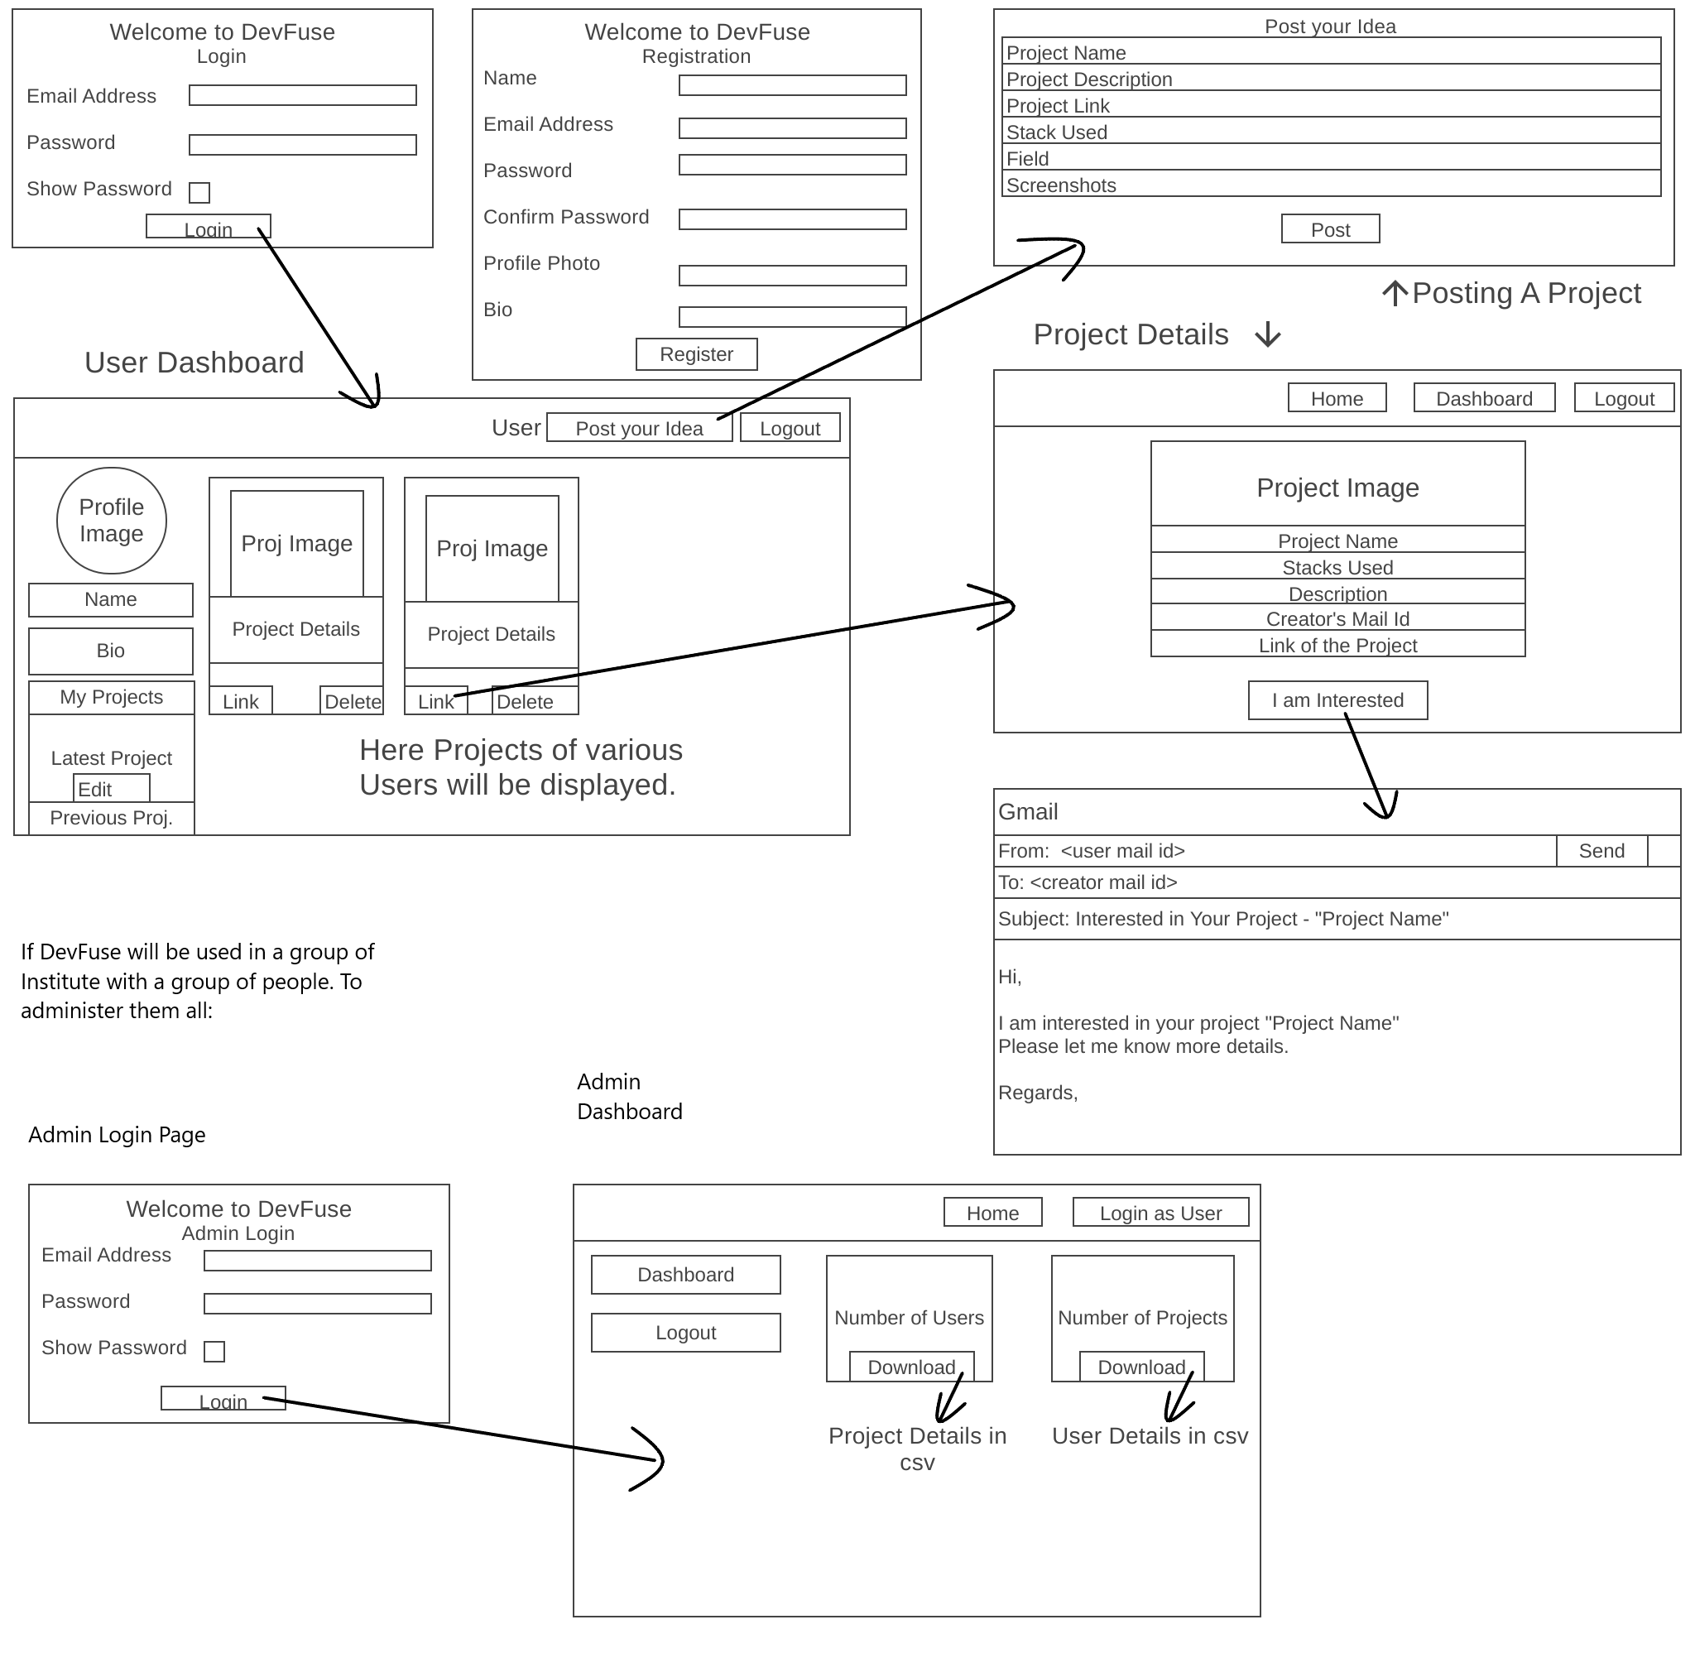
Pre-Alpha Sketch
Click the link to view the draft of the Wireframe of DevFuse
https://drive.google.com/file/d/1h60EAQ2ZzXkqfiz-ml3Bz_5NfTxbH1RB/view?usp=drive_link

Slide 9
Vision: Future of DevFuse
Become the go-to platform for tech collaboration worldwide.
Incorporate advanced AI features for skill matching and project insights.

Slide 10
Why DevFuse Matters?
Fosters growth through teamwork.
Creates new opportunities for innovation.
Empowers individuals to achieve their goals.

